Slide 1
Matching Theory

Slide 2
Two-Sided Matching
Statement of the problem
  Two sides of the market to be matched.
  Participants on both sides care about to whom they are matched.
  Money can’t be used to determine the assignment.
Examples
Marriage & dating markets
Fraternity/sorority rush
School choice programs
College admissions
Medical residencies
Judicial clerkships
Military postings
Job assignments in firms

Slide 3
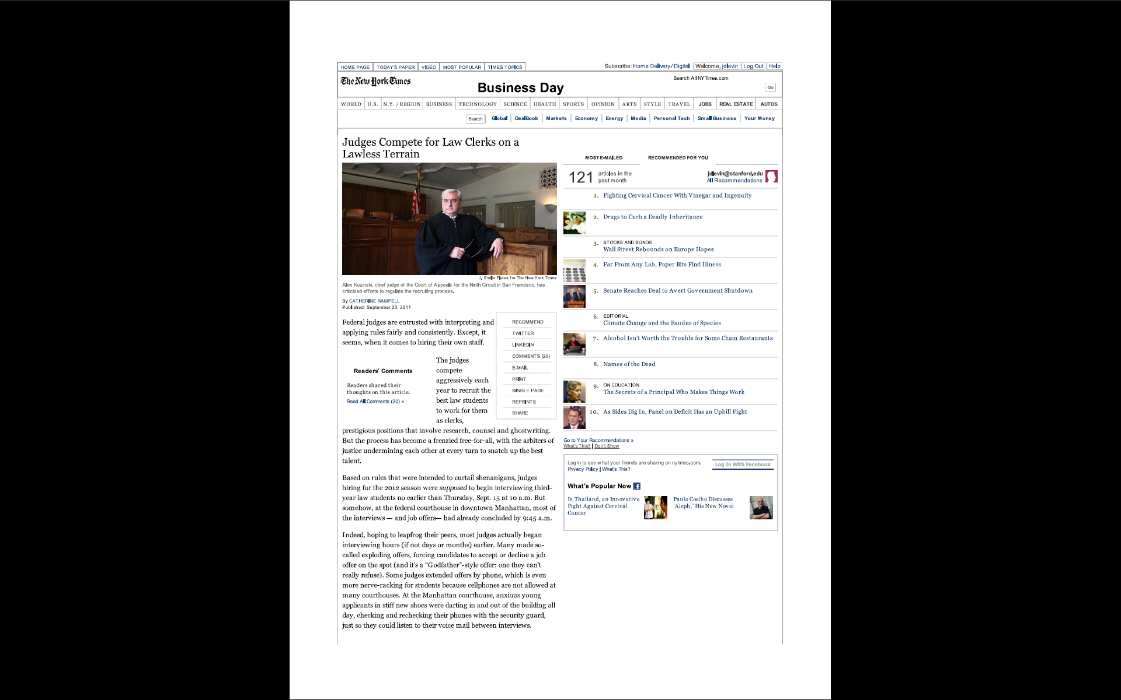

Slide 4
Marriage Model
Participants
  Set of men M, with typical man m∈ M
  Set of women W, with typical woman w ∈ W.
  One-to-one matching: each man can be matched to one woman, and vice-versa.
Preferences
  Each man has strict preferences over women, and vice versa.
  A woman w is acceptable to m if m prefers w to being unmatched.

Slide 5
Matching
A matching is a set of pairs (m,w) such that each individual has one partner.
  If the match includes (m,m) then m is unmatched.
A matching is stable if
  Every individual is matched with an acceptable partner.
  There is no man-woman pair, each of whom would prefer to match with each other rather than their assigned partner.
If such a pair exists, they are a blocking pair and the match is unstable.

Slide 6
Example 1
Two men m,m’ and two women w,w’
m prefers w to w’
m’ prefers w’ to w
w prefers m to m’
w’ prefers m’ to m
Possible match: (m,w’) and (m’,w)
Unique stable match: (m,w) and (m’,w’)

Slide 7
Example 2
Two men m,m’ and two women w,w’
m prefers w to w’
m’ prefers w’ to w
w prefers m’ to m
w’ prefers m to m’
Two stable matches {(m,w),(m’,w’)} and {(m,w’),(m’,w)}
First match is better for the men, second for the women.
Is there always a stable match? How to find one?

Slide 8
Deferred Acceptance
Men and women rank all potential partners
Algorithm
  Each man proposes to highest woman on his list
  Women make a “tentative match” based on their preferred offer, and reject other offers, or all if none are acceptable.
  Each rejected man removes woman from his list, and makes a new offer.
  Continue until no more rejections or offers, at which point implement tentative matches.
This is the “man-proposing” version of the algorithm; there is also a “woman proposing” version.

Slide 9

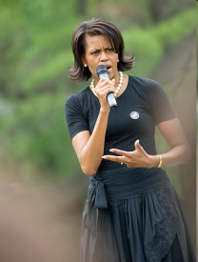
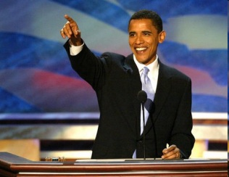

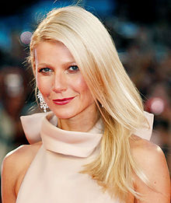




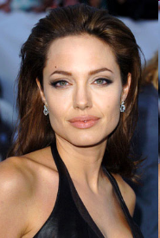

DA in pictures

Slide 10
Stable matchings exist
Theorem. The outcome of the DA algorithm is a stable one-to-one matching (so a stable match exists).
Proof.
Algorithm must end in a finite number of rounds.
Suppose m, w are matched, but m prefers w’.
  At some point, m proposed to w’ and was rejected.
  At that point, w’ preferred her tentative match to m.
  As algorithm goes forward, w’ can only do better.
  So w’ prefers her final match to m.
Therefore, there are NO BLOCKING PAIRS.

Slide 11
Example
Preferences of men and women
m1: w1 > w2 > w3 | w1: m2 > m3 > m1
m2: w3 > w2 > w1 | w2: m2 > m3 > m1
m3: w3 > w1 > w2 | w3: m2 > m1 > m3
Find a stable matching.

Slide 12
Aside: the roommate problem
Suppose a group of students are to be matched to roommates, two in each room.
Example with four students
  A prefers B>C>D
  B prefers C>A>D
  C prefers A>B>D
  No stable match exists: whoever is paired with D wants to change and can find a willing partner.
So stability in matching markets is not a given, even if each match involves just two people.

Slide 13
Why stability?
Stability seems to explain at least in part why some mechanisms have stayed in use.
  If a market results in stable outcomes, there is no incentive for re-contracting.
  We will see in the next class that the clearinghouses using the Deferred Acceptance algorithm have fared pretty well.
  Other clearinghouses that use unstable matching mechanisms seem to have failed more often.
But does one need an organized clearinghouse?

Slide 14
Decentralized market
What if there is no clearinghouse?
  Men make offers to women
  Women consider their offers, perhaps some accept and some reject.
  Men make further offers, etc..
What kind of problems can arise?
  Maybe w holds m’s offer for a long time, and then rejects it, but only after market has cleared.
  Maybe m makes exploding offer to w and she has to decide before knowing her other options.
No guarantee the market will be “orderly”…

Slide 15
Example: clinical psychology
Clinical psychologists are employed as interns after they complete their doctoral degrees. About 500 sites offer 2,000 positions each year. Clears with one day market.
On selection day, market opens at 9 am, closes at 4 pm.
  While market is open, offers will be made and accepted according to a version of the DA algorithm, but a human version where people make phone calls.
  Offers can be accepted early and programs often ask students to indicate in advance their willingness to accept an offer. (You’ll see why.)
Roth and Xing (1994) describe a site visit in 1993.

Slide 16
Example: clinical psychology
Program had 5 positions, 71 applicants, 29 interviews,
  Directors had ranked 20, and knew 6 would say yes if asked. Their strategy: “don’t tie up offers with people who will hold them”.
Timeline on selection day
  At 9:00, calls placed to candidates 1,2,3,5,12 ---- 3,5,12 accept.
  Candidate 1 reached at 9.05, holds until 9.13, rejects.
  In the interim, candidate 8 calls, says she will accept.
  When 1 rejects, call placed to 8, who accepts.
  While call is in progress, 2 calls to reject.
  Call placed to 10 (who’d indicated acceptance), accepts at 9.21.
  By 9.35, remaining candidates informed of non-offer.

Slide 17
Optimal stable matchings
A stable matching is man-optimal if every man prefers his partner to any partner he could possibly have in a stable matching.
Theorem. The man-proposing DA algorithm results in a man-optimal stable matching.
This matching is also woman-pessimal (each woman gets worst outcome in any stable matching).
Note: the same result holds for woman-proposing DA with everything flipped.

Slide 18
Proof
Say that w is possible for m if (m,w) in some stable matching.
Show by induction that no man is ever rejected by a woman who is possible for him.
  Suppose this is the case through round n.
  Suppose at round n+1, woman w rejects m in favor of m’.
    Note: this means m’ made an offer to w in round n+1 and hence all the women m’ prefers to w (who he made prior offers to and who rejected him) must be impossible for him, by the inductive hypothesis.
  Claim: w must be impossible for m.
    Suppose we try to construct a stable matching that pairs (m,w). We need to put m’ with someone, but we can’t put him with a woman he prefers to w (they are impossible for him), and if we put him with someone less preferred, he and w will block.
  So in no round is a man rejected by a possible woman.

Slide 19
Stability vs. Pareto Efficiency
The man-optimal stable match is best for men given stability, but may not be Pareto efficient for the men.
Example: men m1, m2, m3; women w1, w2
  m1: w1 > w2 w1: m2 > m3 > m1
  m2: w2 > w1 w2: m1 > m3 > m2
  m3: w1 > w2
Stable match is (m1, w2), (m2, w1).
But men would be better off if m1, m2 swap wives!
Why is this? … Stability respects women’s preferences as well as men’s. The stability vs Pareto efficiency tension will be important when we discuss school choice.

Slide 20
Rural Hospitals Theorem
Theorem. The set of men and women who are unmatched is the same in all stable matchings.
Why “rural hospitals”? DA is used to assign doctors to hospitals – some hospitals wondered if changing the algorithm would help them fill positions.

Slide 21
Proof of RH Theorem
Let M,W be the sets of men and women matched in the man-optimal stable matching (which is also woman-pessimal).
Let M’,W’ be the sets of men and women matched in some other stable matching.
Any man in M’ must also be matched in the man-optimal stable matching, so M’⊆ M … and also |M’| ≤ |M|.
Any woman matched in the woman-pessimal stable matching must also be in W’, so W ⊆ W’ … and also |W| ≤ |W’|.
In any stable matching, the number of matched men equals the number of matched women, so |M|=|W| and |M’|=|W’|.
Therefore |M’| = |M| = |W| = |W’|.
And so we must have M=M’ and W=W’.

Slide 22
Strategic Behavior
The DA algorithm asks participants to report their preferences. Should they report truthfully or be strategic?
Definitions:
  A matching mechanism is a mechanism that maps reported preferences into an assignment.
  A mechanism is strategy-proof if for each participant it is always optimal to be truthful.

Slide 23
DA is strategy-proof for men
Theorem (Dubins and Freedman; Roth). The men proposing deferred acceptance algorithm is strategy-proof for the men.
Proof.
Fix the reports of all women and all but one man.
Show that whatever report the man m considers making, there will be a chain of (weak) improvements leading to a truthful report.

Slide 24
Proof
Suppose m is considering making a report that, fixing the reports of others, will lead to a match x where he gets w. The following changes improve his outcome
Reporting that w is his only acceptable woman.
  DA will still result in him getting w – as if he “sat out” the rounds before he otherwise would have asked w.
Reporting honestly, but truncating at w.
  Can’t hurt to ask women he likes better – he might get one and if not, he can still get w even asking at the end.
Reporting honestly with no truncation.
  This won’t affect DA relative to above strategy.

Slide 25
DA not strategy-proof for women
Example (two men, two women)
  m prefers w to w’
  m’ prefers w’ to w
  w prefers m’ to m
  w’ prefers m to m’
Under man-proposing DA algorithm
  If everyone reports truthfullly: (m,w),(m’,w’)
  If w reports that m is unacceptable, the outcome is instead (m,w’),(m’,w) --- better for w!

Slide 26
Strategic behavior
The example on the previous slide can be used to establish the following result.
Theorem. There is no matching mechanism that is strategy-proof and always generates stable outcomes given reported preferences.
Both versions of DA lead to stable matches, so neither version is strategy-proof for all participants!

Slide 27
How many stable matchings?
Evidently, the incentives and scope for manipulation depend on whether preferences are such that there are many stable matchings.
If there is a unique stable match given true preferences, there is no incentive to manipulate if others are reporting truthfully.
When might we have a unique stable match?
  Ex: if all women rank men the same, or vice-versa.
  In “large” markets? We’ll come back to this later.

Slide 28
Summary
Marriage model captures generic situation in which
  Participants on two sides must be matched one-to-one.
  Participants care about who they get matched with.
Stability is a desirable outcome in this problem.
Deferred acceptance algorithm finds a stable match
  Man-proposing version also finds stable match that is optimal for the men, and induces men to be truthful.
  Women may have some incentive to manipulate the algorithm by truncation, if they can identify an opportunity.
Next time we will start to look at applications.

